Slide 1
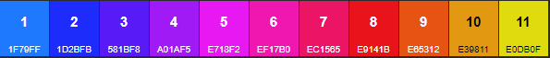
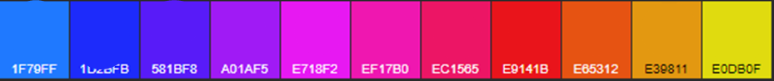

10
20
30
40
50
60
70
80
90
100
v
10
20
30
40
50
60
70
80
90
100

Slide 2
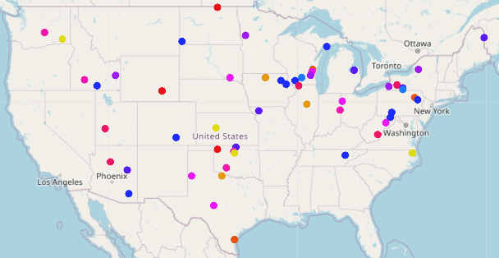
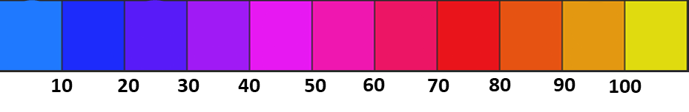

Slide 3
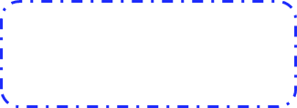
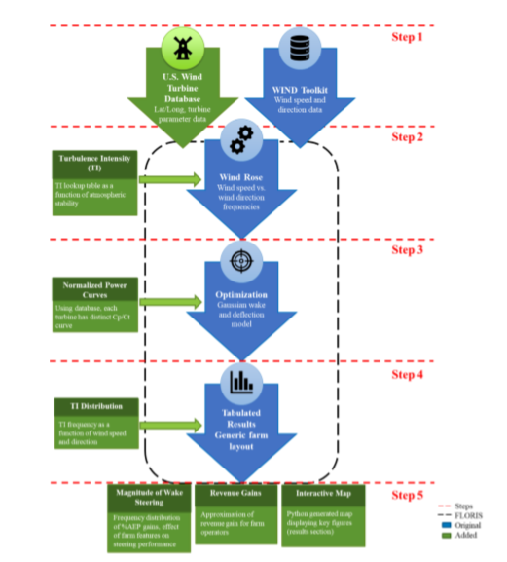
Turbulence Intensity Model
Optional Features
Reference Turbine Normalization
FLORIS
WIND Toolkit
Wake Steering Performance Results
Wind Rose
Optimization
U.S. Wind Turbine Database
Gauss Curl Hybrid Model
Wind Direction Variability

Slide 4
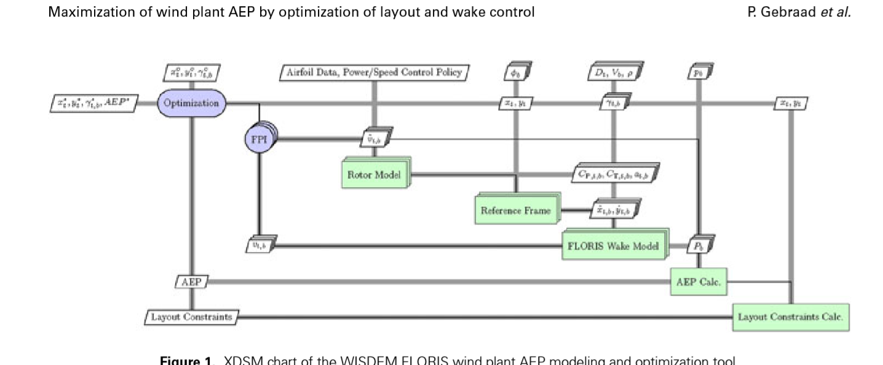
Turbulence Intensity
NREL 5MW Reference Turbine
WIND Toolkit
Turbine Power/ Thrust curves
AEP No -Wake
Turbine Objects
AEP Baseline
Input File
Wind Rose
AEP Optimized
Farm Objects
Yaw Angle Optimization
USWTDB
Wake and Velocity Model
BOS and LCOE Analysis
Wind direction Variability
Turbine Model
Onshore Farms Macro Trends

Slide 5
Stage 1
NREL 5MW Reference Turbine
Wake and Velocity Model
Turbulence Intensity Classification
Stage 2
Stage 3
Stage 4
FLORIS
Turbine Power/ Thrust Curves
Input File
Wind Farm Performance Summary
Yaw Angle Optimization
Farm Layout
Wind Rose
USWTDB
Wind Direction Variability
WIND Toolkit

Slide 6
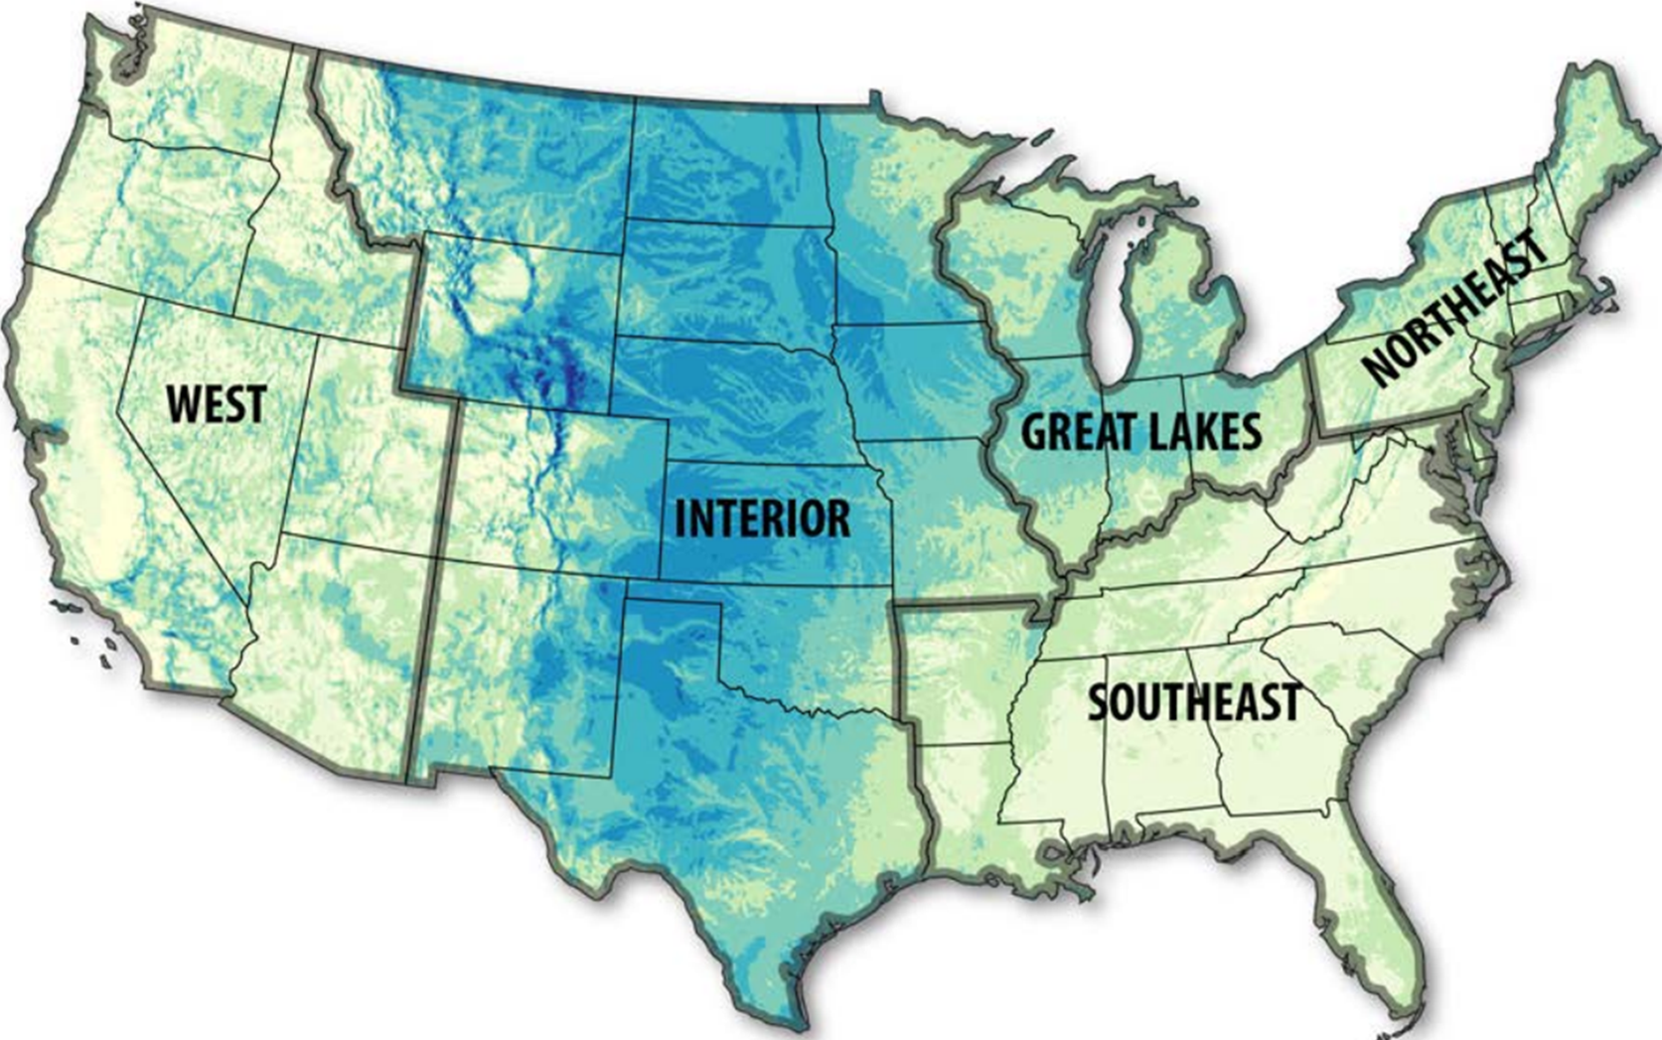
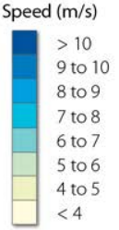
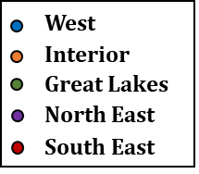
West
Interior
Great Lakes
North East
South East
b

Slide 7
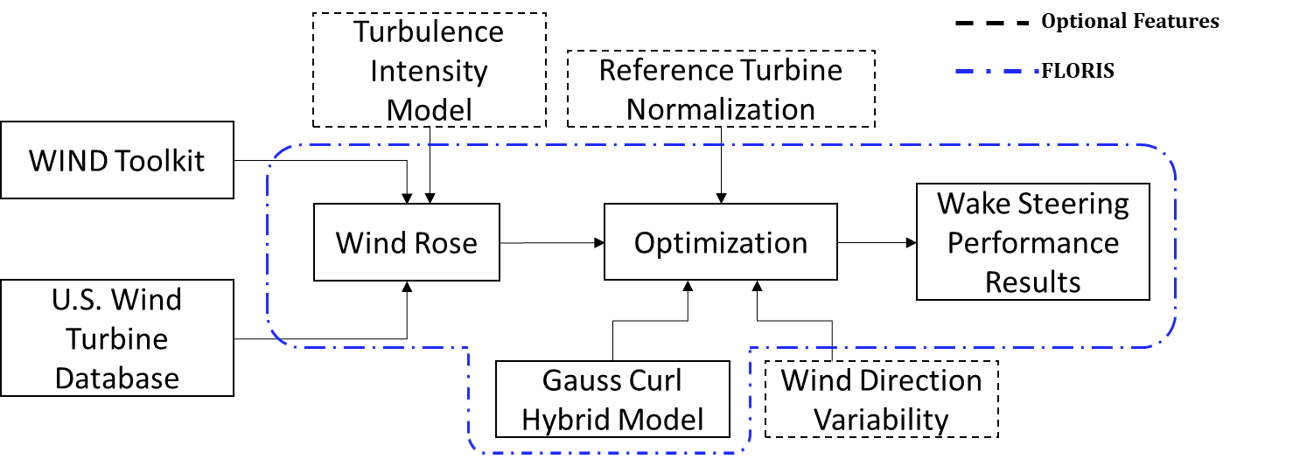

Slide 8
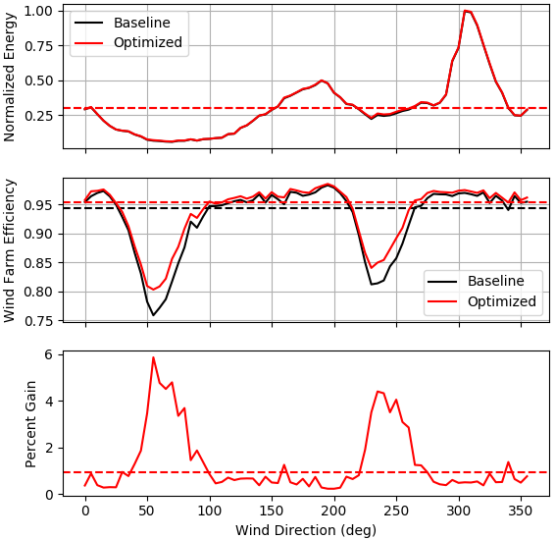
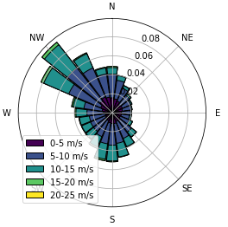
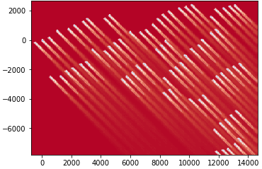
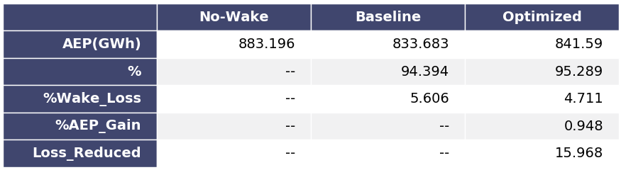

Slide 9
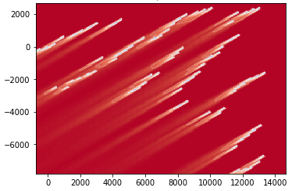
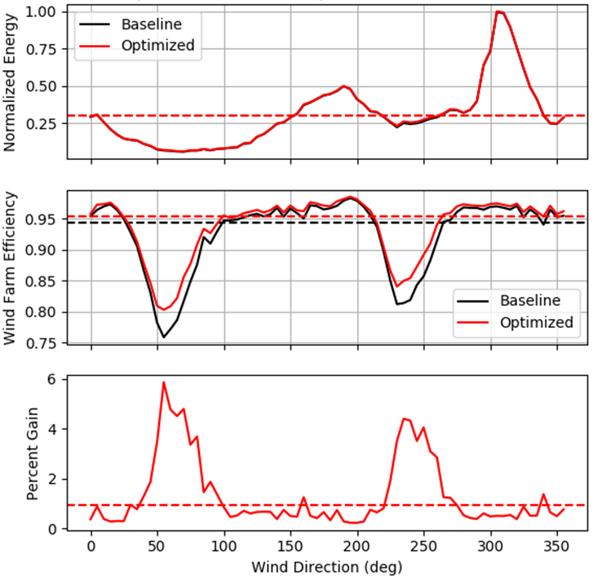
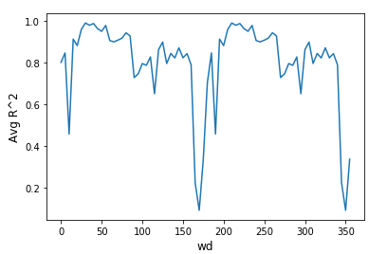
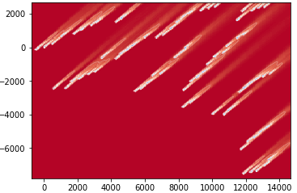
Region 1
Region 2
Northing (m)
a
Region 1
b
Northing (m)
Region 2
c
Easting (m)

Slide 10
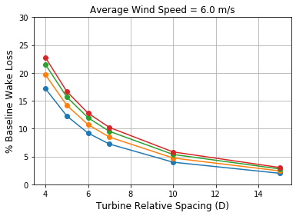
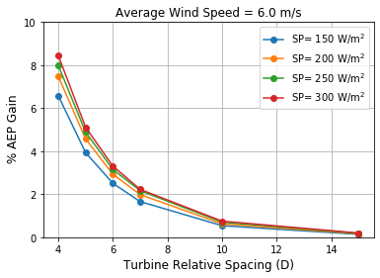
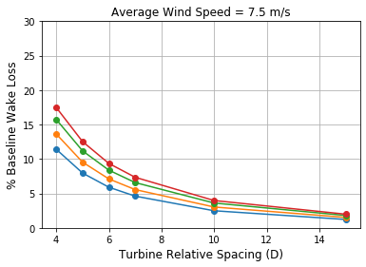
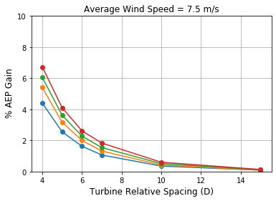
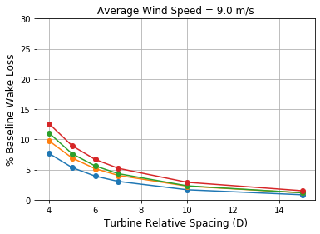
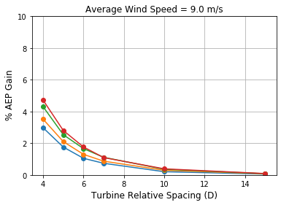
a
d
b
e
c
f

Slide 11
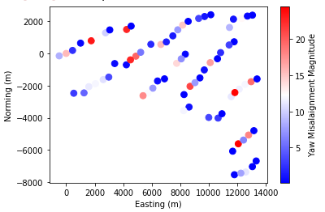
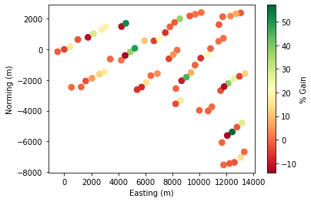
i
i
Northing (m)
Northing (m)
U= 10 m/s
ii
ii
a
240°
Easting (m)
Easting (m)
b

Slide 12
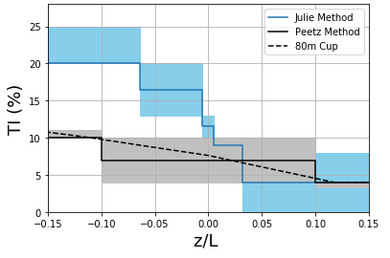
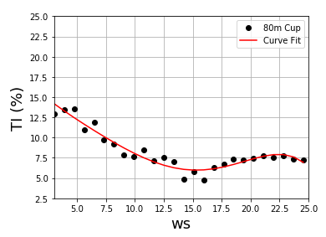
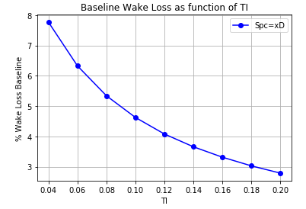
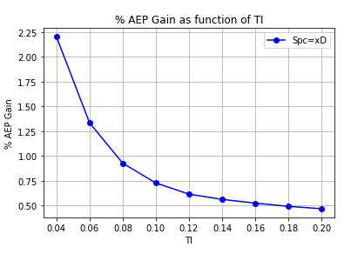

Slide 13
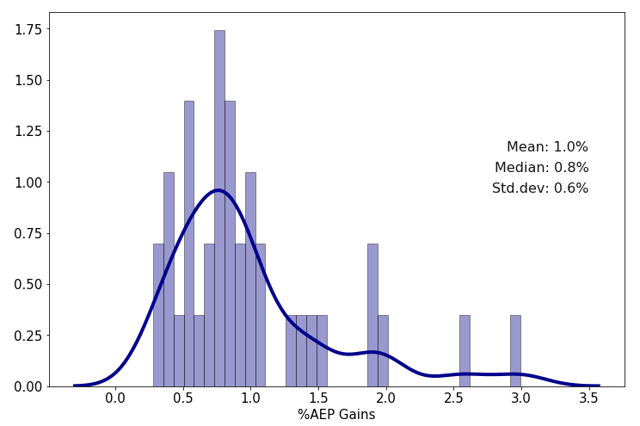
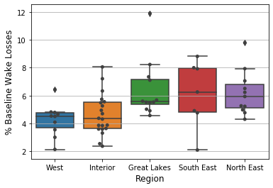
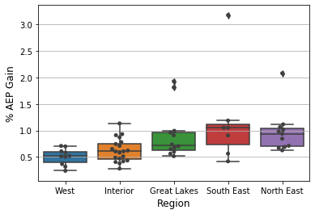
a
b

Slide 14
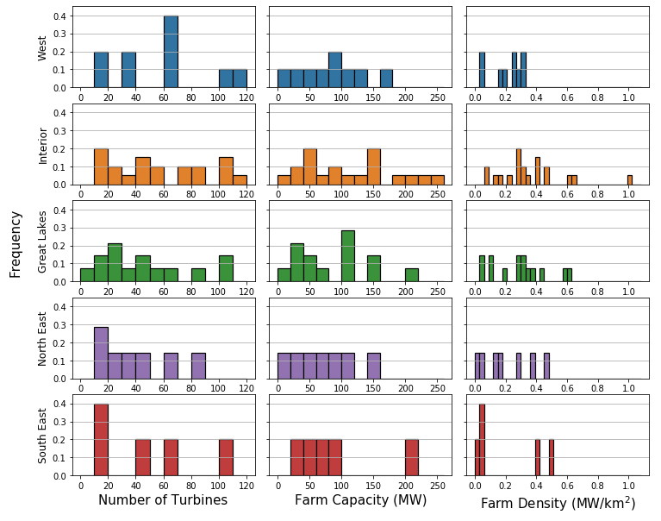
10
20
12
11
7

Slide 15

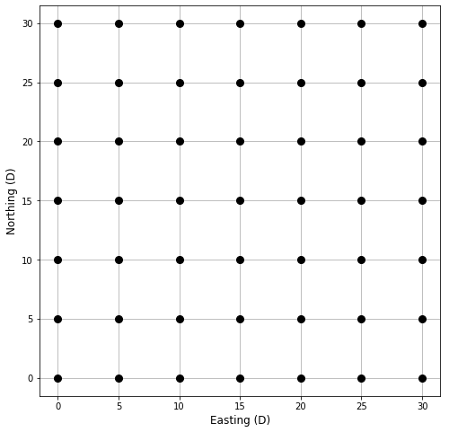
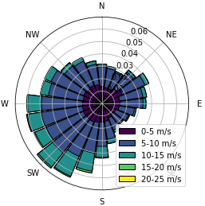
Ohio
5D
5D
a
b

Slide 16
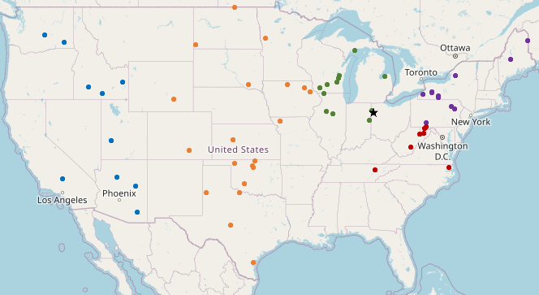






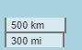
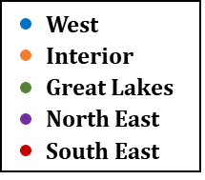
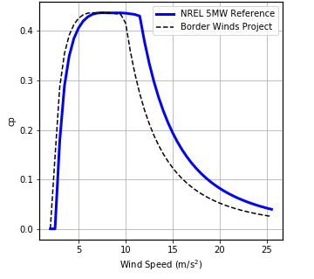
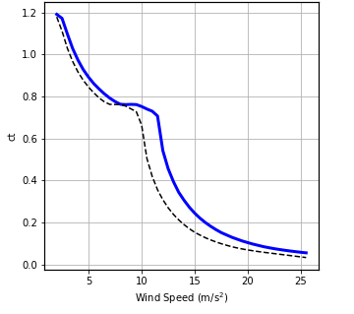
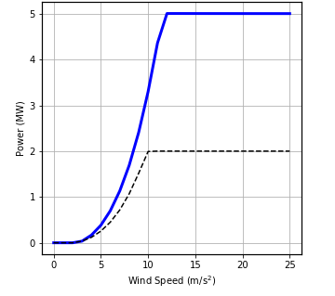
West
Interior
Great Lakes
North East
South East
a
a
b
c
C_{p}
C_{t}
Power (MW)
U_{r,farm}
U_{r,ref}
I,I
II
II
III,III
Wind Speed (m/s)
Wind Speed (m/s)
Wind Speed (m/s)

Slide 17
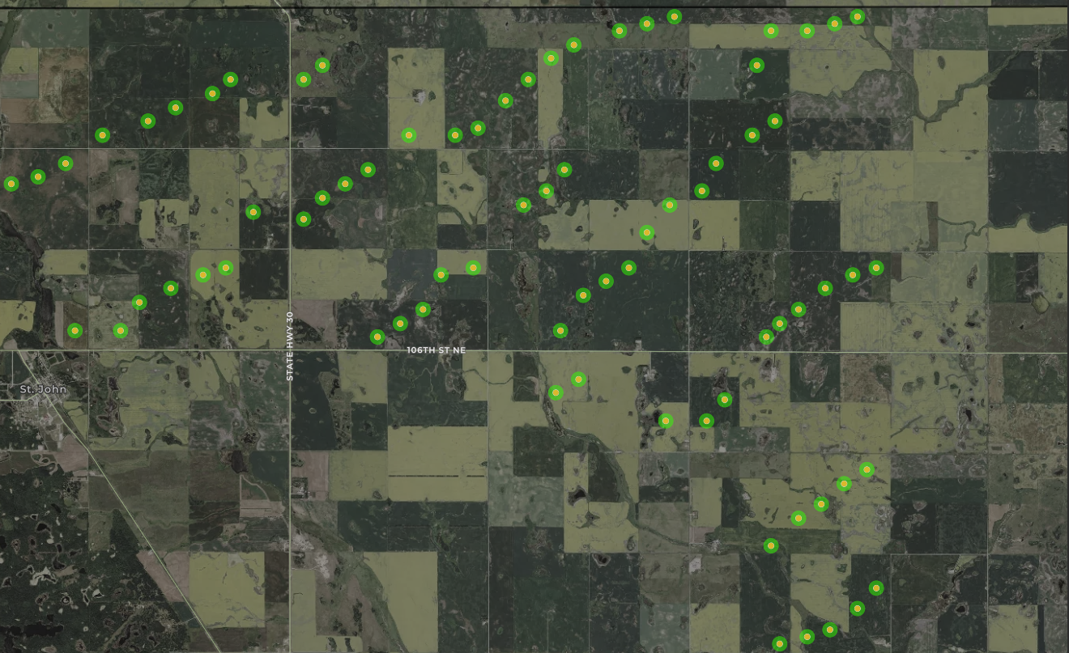
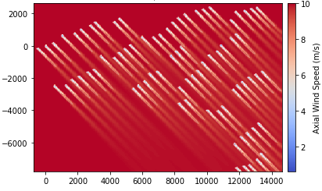

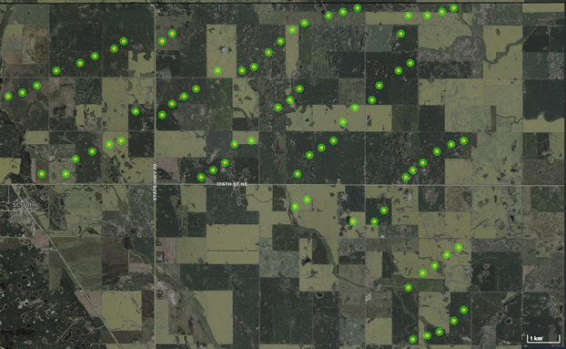
Northing (m)
a
1km
Easting (m)
b
b

Slide 18
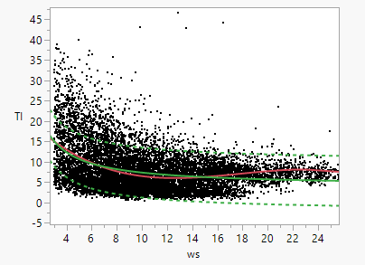
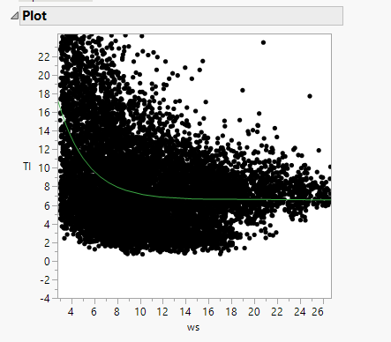
Ideas to do with TI section
Using the wind speed vs. TI plot.
We find a fit (will be exponential as well as the 95 or 80% confidence fits that go with it). These will include quite a range of TI since there is so much scatter in the data.
Pros – runtime (computational will not increase a lot) for a farm we would do three runs (fit, upper and lower values) and say that these are the spreads we can expect in AEP using this model.
Cons – Wind speed vs. TI isn’t as popular as the z/L method in literature and might be harder to reason since we have z/L data also available.

Slide 19
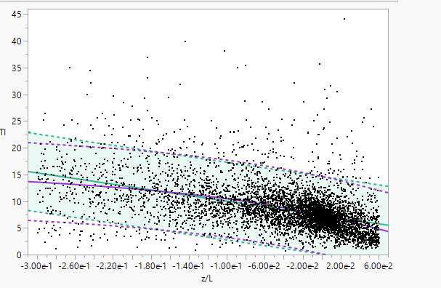
Idea 2: Use the same approach but for the z/L data from Peetz. Based on a cubic fit to the data (raw or binned) we can get 3 curves with confidence fits for upper and lower bounds.
Would be best if we look at particular section rather than all of the data (Mithu suggested -0.3 to 0.06 or something)
Pros: This method seems more popular in literature for classifying atmospheric stability indirectly.
Cons: Much more computationally expensive. For one farm we would do three runs with 5x more iterations each.
I think it is reasonable to choose one of these methods for the report and depending on which for x amount of farms. It will result in a large range of AEP gains, but since this is still an active area of research, that is alright. This just suggest a new method for accounting for TI for a generic farm. Once better models existed, this method can be adapted.
Doing three different methods would be interesting but doesn’t really show anything since we don’t know which is best. But like this, we can say what our confidence is in the results since we look at the upper and lower ranges based on the raw data.

Slide 20
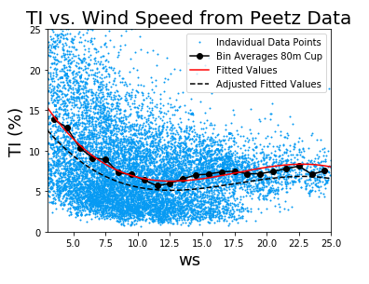




For a generic 7x7 gridded farm layout, avg_ws = 7.5 m/s, rel_spc = 7D, SP = 200
Mean_TI = 9.78%
Scale_factor = 0.08 / 0.0978
All ti values multiplied by this to make the black dashed curve
red

Slide 21


Mean = 7.18%
Scale_factor = 0.08 / 0.0718
 | z/L < -0.10 | -0.10 <z/L < -0.05 | -0.05<z/L < 0 | 0 <z/L < 0.05 | 0.05<z/L
Original | 11 | 10 | 8 | 6 | 5
Scaled | 11.8724 | 10.7931 | 8.63440 | 6.4758 | 5.3965

Slide 22




Ideas for TI. Why would we just look at a function of spacing? Maybe split it up by AEP baseline regions (high, low, etc). Or wake loss (how do they compare). – Try on JUMP
a
a
b
b

Slide 23

s
0
s

Slide 24





Slide 25


a
b

Slide 26




a
b
a
b

Slide 27

10
20
12
11
7

Slide 28
Turbine Spacing | AEP Gain basic | AEP Gain with wd unc | Baseline Wake loss OG | Baseline wake loss UNC | % Abs Difference between wake loss | % Abs Difference between AEP gain
4 | 5.404 | 3.401 | 13.63 | 13.85 | 1.601164483 | 45.49687677
7 | 1.317 | 0.609 | 5.56 | 5.73 | 3.011514615 | 73.52024922
10 | 0.418 | 0.109 | 3.03 | 3.13 | 3.246753247 | 117.2675522

Slide 29




a
b
c
d

Slide 30


 | Without wd var. |  | With wd var. |  | % Change
Relative Spacing | % Baseline Wake Loss | %AEP Gain | % Baseline Wake Loss | %AEP Gain | AEP Gain
4.0 | 13.6 | 5.4 | 13.9 | 3.4 | -37.1
5.0 | 9.5 | 3.2 | 10.4 | 2.0 | -37.2
6.0 | 7.1 | 2.0 | 7.8 | 1.1 | -44.9
7.0 | 5.6 | 1.3 | 5.7 | 0.6 | -53.7
10.0 | 3.0 | 0.4 | 3.1 | 0.1 | -73.9
15.0 | 1.5 | 0.1 | 1.5 | 0.0 | -86.6
a
b

Slide 31



New Creek Wind, South East
Mars Hill, North East
Northing (m)
Northing (m)
a
b
Easting (m)
Easting (m)

Slide 32






Maybe filter for groups more than 5 or 6 turbines?
Or add weighting for the size of the sub farm.

Slide 33



Slide 34
Parametric Study Questions we want to answer.
How do the parameters of the farm (rel spc, avg_ws and SP) effect the AEP (baseline and opt, use AEP gain) and wake loss? What are the relative effects of each (weight, importance).
What are the effects of the same parameters on the BOS for baseline and optimized cases (IS BOS ALL WE CARE ABOUT Or other (capex etc).
Effect on the LCOE as a function of these two. Relative effect of each.
We could look at a range of BOS costs and see the respective %change in LCOE when using wake steering.
One goal would be to link this potential to the results from the first section, but also suggest the potential for wake steering through LCOE gains as a function of the farm parameters (although this is a grid case, it is still applicable in certain regions such as interior etc. where there is space?).

Slide 35






Question 1: AEP gain and baseline wake as function of the parameters
The general behavior is consistent, regions with high baseline wake loss have high potential for wake steering
High SP leads to wake loss, low spacing, and low wind speed. -> Explain why that is.
Low spacing – more dense, effects of wakes are more substantial (this has been shown)
Low wind speeds have higher thrust coefficients and hence more wake losses.
High SP have larger thrust coefficients (same reason as ws?)
These plots are good to visualize the core trends, but not the relative importance or weight of each parameter on the AEP gain.

Slide 36




Second order model showing the importance of each parameter on the AEP gain
A second order fit following the prediction equation listed has a good agreement between actual simulated values and predicted (R^2 very high). The effects test show that (idk if this is what it shows). The parameter estimates do show the relative importance of each value in expression and hence the importance. Idk if there is a single value somewhere that says which matters most.
Prediction profiler is good to show trends again, but the slopes of the lines change depending on the positions? Choose best one or use different plot? Something like Owen had where there were several plots?

Slide 37
Relative Spacing | Without wd var. %AEP Gain | With wd var. %AEP Gain | %AEP Gain with z/L TI method | %AEP Gain with ws TI method | % change in AEP gain with wd variability | % change in AEP gain with z/L method | % change in AEP gain with ws method
4.0 | 5.4 | 3.4 | 6.1 | 5.8 | -37.1 | 13.6 | 8.2
5.0 | 3.2 | 2.0 | 3.9 | 3.6 | -37.2 | 22.3 | 12.3
6.0 | 2.0 | 1.1 | 2.6 | 2.3 | -44.9 | 27.4 | 12.4
7.0 | 1.3 | 0.6 | 1.8 | 1.5 | -53.7 | 37.5 | 16.7
10.0 | 0.4 | 0.1 | 0.7 | 0.5 | -73.9 | 61.1 | 27.8
15.0 | 0.1 | 0.0 | 0.2 | 0.1 | -86.6 | 146.7 | 62.0

Slide 38


Location of peaks is consistent with the layout (0, 90, 180, 270)
The z/L method always seems to have the highest peaks, at least in the regions with large gain potential.
Looking at change to the baseline 8% case, the peaks are min points (large abs difference but not that great relative to original value). The regions with less abs gain seem to have the highest difference in AEP.
Some wd even have negative meaning the 8% TI case was outperforming. These are cases where no gain was expected anyway (gains close to 0). Would make sense since the higher TI from models would make those minimal gains even worse, and the lower TI values benefit where the gains were high?
What is the reason for negative effects at certain wind directions? Places where gains are already close to 0 and this TI method seems to make it worse?

Slide 39

7D, 200 W/m^2, avg_ws=7.5m/s
We can see that with wd var. the efficiency is a bit higher at certain places and lower at others
Red peaks with z/L method is consistently highest peaks on efficiently with the blue (ws method) is close by.
All methods have some negative on the \% change (which is relative to the og 8%). Wind direction var. has most often which leads to a smaller net AEP. The others are usually higher, negative in areas where the gain is already low anyway.
The peaks for wd var are at places where the gain is already low. WHY? –
Same for the largest peaks for blue and red are also at low gains (but this is relative)
Regions of less gain are at inefficient regions
Peaks of wd var are at efficient places

Slide 40








1
4

Slide 41




Second order model showing the importance of each parameter on the baseline wake losses
Similar to before there is a good fit and once again the behavior of each value is similar to the AEP gain, although this time the avg_ws^2 is in the equation since it has more weight, but still not much shown bty the prob >F.
This kind of just goes with the AEP prediction plot since we already showed that they are related, although not directly.

Slide 42





Question 2: Effect of parameters on the BOS
General trend makes sense. Higher spacings lead to higher BOS due to site prep, management, roads etc.
With increasing SP, the foundation cost goes up? Ask Owen about this trend
As shown, the SP has a larger effect on the BOS than the rel_Spc. This agrees with what Owen showed us

Slide 43




Question 3: Look at relationship for LCOE. (show %change in LCOE)
These plots don’t really an inflexion point or the relative effects.
Higher SP tends to lead in an decrease in LCOE (this is consistent with larger effect on BOS that goes down with higher SP).
Decrease in rel_spc causes LCOE to go down. The increase of BOS is minor compared to the increase in AEP gain with smaller spacing (pays off).
The lower average wind speed leads to lower LCOE. Since this only effects the AEP, where we see higher gains for lower average wind speeds, this is consistent.

Slide 44








a
d
b
e
c
f

Slide 45


Slide 46




Look at relationship for LCOE. (show %change in LCOE) second order model
Main driver is still the spacing. Although no heavy effect on the BOS, has huge weight for the AEP gain.
We can already start seeing an inflexion point with the turb spacing, where larger (maybe 13D) would already yield heavier effects on BOS than AEP gain since there are so few wake loss.

Slide 47
Main takeaways
The inflection point for the LCOE is at a relatively high relative spacing. (around 10D). – Reason for this is because the AEP gains dip at high spacings like that.
As wake steering is most effective for low turbine spacings, there is a substantial decrease (15%) in LCOE for dense farms. --- This shows a lot of potential for existing farms in the North and South East as well as the great Lakes – since these are dense.
If we were to choose a constant BOS, what kind of decrease in LCOE will we see for a typical spacing, average wind speed and spacing..
What are the implications of this study on the farms we ran (very dense farms will have good decreases in LCOE.
When building farms in this grid style, it is worth making a denser farm and using wake steering since it will have a substantial cut on the LCOE.
MAIN QUESTION = what is the potential of wake steering at different levels of these farm parameters. Showed the absolute effect. Show relative effect on the LCOE. High potential for dense farms with low average wind speeds and high SP. This would be perfect method for farms outside the wind belt (west, south east, north east etc.).

Slide 48








For all wind speeds, the general trend is the same where with increasing Spacing, the AEP and baseline wake loss goes down. At higher SP the curves are shifted up systematically, although the sensitivity becomes smaller as the spacing goes up.
a
a
b
b
c
c
Parameter | % AEP Gain | % Baseline Wake Loss
Relative Turbine Spacing
Average Wind Speed
Turbine Specific Power

Slide 49



Some BOS plots
Not a large effect of turb spc on BOS costs, and the effect of SP seems to grow close to linear

Slide 50




Say we are looking at a constant LCOE of 50 Dollars.
The optimized wake steering can achieve this at a denser farm of x% given the same SP, saving x in BOS.
a
b

Slide 51




Slide 52

What parametric study section could look like:
Keep BOS CONS.Baseline AEP no wake steering – keep BOS of 15D and 150W machine across all spacings (and wind speed)
Keep BOS CONS. Wake steering AEP – keep BOS of 15D and 150W machines
Keep AEP CONST.BOS no wake steering – Use AEP baseline of 15D and 150W machine across all spacings and wind speeds?
BOS and wake steering – Use the optimized AEP result (or is this what we have now that is a combination of all both of them).
Curve accounting for both BOS and AEP – what is shown now..

Slide 53
General behavior of Aep gain and baseline wake loss as a function of relative spacing is consistent with theory and results seen from the actual wind farms. As Baseline wake losses go down, so do the AEP gains.
AS average wind speed goes down, the baseline wake losses increase. This is because lower wind speeds have higher thrust coefficients, and hence more prominent wakes. As a result, AEP gains go up with decreasing wind speed.
As the SP of the machine goes up, the wake losses also increase. This is similar the reasoning with the wind speed, since higher SP has a larger region 2 region, hence more time spent not at rated (wake losses are prevalent).
We can also see that the AEP gains converge at 7 and 10D spacing between 7.5 and 9 m/s.
a
a
b
b
c
c

Slide 54
Could summarize %AEP Gain in a table
a
a
a
b
b
b
c
c
c

Slide 55
When fitting a second order model, the predicted vs. actuial values show a very strong corelations (with R2 value of bla bla). Furthermore, the scaled estimates (describe what this is) tell us which parametres are the most critical.
As we can see, for both AEP gain and wake loss, the relative spacing carries the most weight, and is inversely proportual as we saw from the other curves.
In general, the parameters are more correlated to the baseline wkae losses (also has stronger fit), but the relative magnitudes match quite well. Hence, we can conclude that the main driver amongst the paremtres we looked at is the relative spacing, average wind speed, and turbine specific power.

Slide 56

The wind reasouirce and hence average wind speed does not effect the BOS cost. This plot already clearly shows that the SP has more weight than the spacing, as seen by the shallow slops of the curves.
The increase of SP leads to decrease in BOS, and increase in spc leads to increase in BOS
It might not be worth showing the second order fit since these values are not the product of any simulations and can be explained by the equations and input parameters used for them. But the scaled estimate show the SP has a negative corelationsand spacing a positive shallower corleaton.

Slide 57





Slide 58






The abs LCOE curves for both the baseline and optimized cases show promotisisng effects. Given a set LCOE, the spcaing can be reduced by quite a bit saving on the BOS costs marginally as well. Hard to see inflection point on this, but the 15D results might show this.
Reducuting in absolute LCOE increases as the spacing dimininsihed, converges at higher spacings since the wake steering benefits no longer outweigh the additional BOS costs for a larger farm.
As the average wind speed goes up, the the abs effects on LCOE will go down (hard to see but the x axis curves tend to be changing) .
a
b
c

Slide 59

Consider using abs baseline and optimized LCOE instead of the change
But this shows that the main driver for LCOE is the sapcing (due huge AEP gains with lower spacings)……

Slide 60




a
b

Slide 61






a
b

Slide 62
Source | Baseline AEP | % AEP Gain | LCOE Baseline | % LCOE Change
Intercept | 944.1 | 1.5 | 47.6 | -0.03
X | 275.6 | -0.9 | -22.3 | 0.02
Y | 157.6 | 0.5 | 11.1 | -0.01
Z | 53.1 | -2.6 | -9.6 | 0.06
X^2 | -38.0 | 0 | 10.1 | 0
Y^2 | -27.2 | 0 | 0 | 0
Z^2 | -27.0 | 1.6 | 5.9 | -0.03
XY | 102.6 | 0 | -8.5 | 0
XZ | 0 | 0.9 | 7.0 | -0.02
ZY | 18.8 | -0.4 | -3.9 | 0.01
XYZ | 0 | 0 | 0 | 0
Independent Variable | Symbol
Average Wind Speed | X
Turbine Specific Power | Y
Turbine Relative Spacing | Z

Slide 63
New Plots for Color Adjustment and making sure all fonts and sizes etc. are consistent.

Slide 64


a
b

Slide 65


b
a

Slide 66


a
b

Slide 67






d
e
f
a
b
c

Slide 68






d
e
f
a
b
c

Slide 69



Slide 70






a
b
c
d
e
f

Slide 71



a
b
c
d
e
f

Slide 72



Slide 73


a
b

Slide 74
TI (%)
TI (%)
a
b
Wind Speed (m/s)
z/L

Slide 75

If we add in this plot:
Although we see that the average time spent yawing above 1 percent is high, the frequency of time turbines spend yawing above 5 degrees is small, where the most frequent is 0.
a

